Slide 1

P-121
NLP - Text Summarization Model
Presented By :-
1) Gulam Ashraf Mukhtar Ahmed Shaikh
2) Miss. Arpitha S
3) Mr. Nanda Kishor P S
4) More Ashok Sudhakar
Mentoring By :-
Munmun Bhagat

Slide 2
Business Problem:
NLP - Text Summarization Model
Objective:
Text summarization is one of the most interesting problems in NLP. It’s hard for us, as humans, to manually extract the summary of a large document of text.
To solve this problem, we use automatic text summarization. It’s a way of identifying meaningful information in a document and summarizing it while conserving the overall meaning.
The purpose is to present a shorter version of the original text while preserving the semantics. Here, you can use different traditional and advanced methods to implement automatic text summarization, and then compare the results of each method to conclude which is the best to use for your corpus

Slide 3
Project Architecture / Project Flow
Business Problem
Meaningful Text Data Collection
Text Data Cleaning
(Pre-processing the data)
EDA and Feature Selection
Model Building and Testing
Deployment

Slide 4
Data Set Details :-
The data file contains around 41k text words.
(around 3k lines or 300 pages of text data)
From a different domain of research papers
for pre-processing the text data file.

Slide 5
Exploratory Data Analysis (EDA)
First load the text contains data as a input
We have 41k text data.
We do data cleaning and EDA
(Word Tokenization, Stopwrod, lemmatize and more...)
We got final data set after EDA contains 26k text data
- 41971 during the Manual Approach its reduce to 26136 after Data cleaning & EDA
- It is still has a big lenght now we going to do model.

Slide 6
Extractive Text Summarization - Model Building
We build 5 different types of summarization models
Model approach is based on Extractive Text Summarization
Extractive Text Summarization Model
1. sumy Text Rank | - Sumy is a textrank based machine learning algorithm.
2. Lex Rank | - This is an unsupervised machine learning based approach in which we use the textrank approach Using cosine similarity and vector based algorithms
3. Luhn | - This approach is based on the frequency method; here we find TF-IDF (term frequency inverse document frequency).
4. LSA | - This is based on decomposing the data into low dimensional space. It has the ability to store the semantic of given text while summarizing.
5. KL-SUM | - It selects sentences based on similarity of word distribution as the original text. It uses greedy optimization approach and keeps adding sentences till the KL-divergence decreases.

Slide 7
Model Evaluation
Extractive Text Summarization Model
 | Models | Bleu Score | Rogue Score | Len of text summary of 41k
3 | Sumy Text Rank | 3.444903e-232 | 90.2 | 36764
1 | Lex Rank | 5.471622e-232 | 18.2 | 5162
0 | Luhn | 4.512535e-232 | 35.2 | 10627
2 | LSA | 5.471622e-232 | 18.2 | 5162
4 | KL-SUM | 1.513399e-231 | 18.2 | 42
As you see ‘Sumy Text Rank’ and ‘Luhn’ are giving us the highest Rogue Score value but out of these only ‘Luhn’ giving us high Bleu Score value. But by considering the ratio on text summary length with the original test data, ‘Lex Rank’ and ‘LSA’ has the best approach to the summary.
So, By considering all the parameters the best approach to get the summary of input text data is ‘Luhn Models’ as a best fit model over all the parameter for text summarization.
Finaly, We choose ‘Luhn Models’ for deployment.

Slide 8
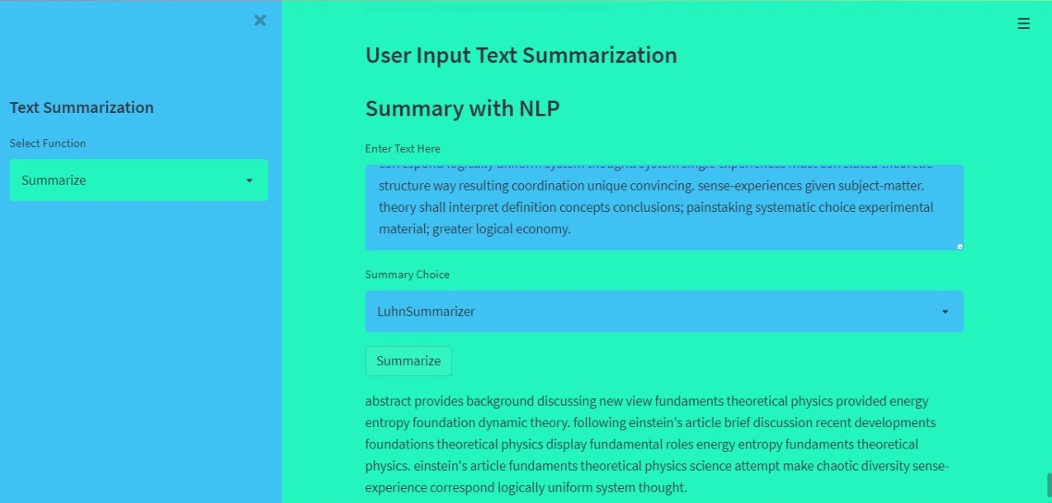
Deployment
Deployment Front View

Slide 9
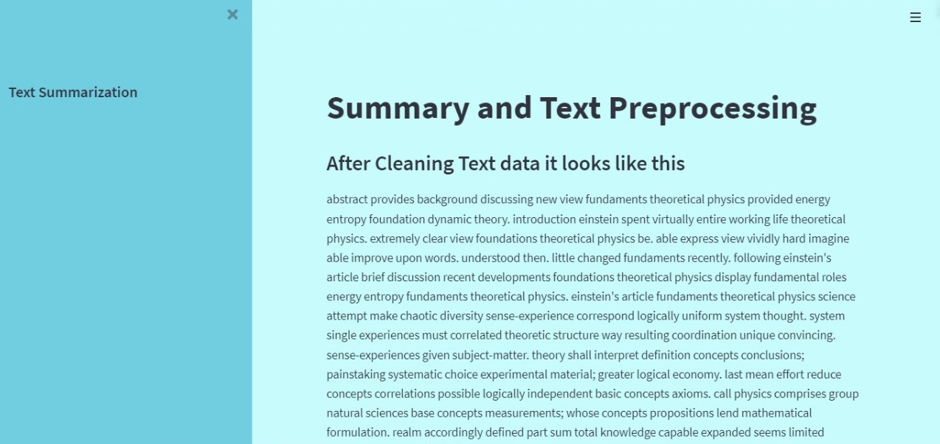
Deployment
After cleaning and pre-processing the input data,
We give that data to the selected model as a input as you see in deployment

Slide 10
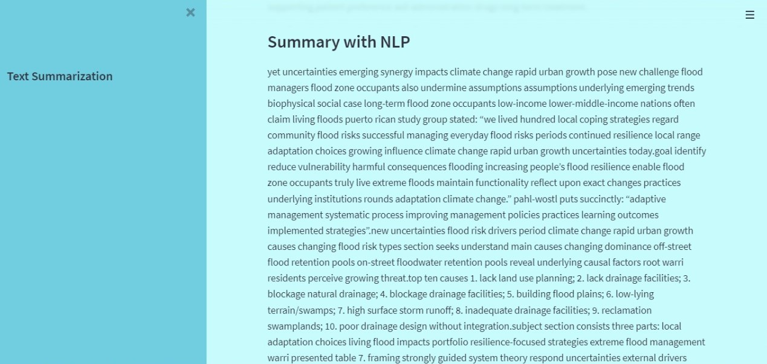
Deployment
Finally, We get this summary as a output by selected model in deployment

Slide 11
Thank you

